Slide 1
Week 1: Introduction and Fast Basics of C#
.NET Development Workshop Series

Slide 2
What is the .NET Framework?
The .NET Framework is a managed execution environment that provides a variety of services to its running applications. It consists of two major components: the common language runtime (CLR), which is the execution engine that handles running applications; and the .NET Framework Class Library, which provides a library of tested, reusable code that developers can call from their own applications.
In short, it’s just an environment that allows us to use their library and build applications.
There are many programming languages that are able to build applications for different platforms, but we’re focusing on building apps for Universal Windows Platform (UWP) using C#.

Slide 3
.NET Languages and Platforms
Languages
C++/CLI
C#
Platforms
Win32
Universal Windows Platform (UWP)
JavaScript
F#
Visual Basic .NET
Windows PowerShell
A hell lot more you never heard of
ASP.NET
Xamarin/Mono
Silverlight

Slide 4
Quick Survey
How much do you know about coding/programming?
1. Super new, what’s that BTW?
2. My course made me learn that… So yeah
3. Somewhat comfortable with it.
4. I’m not here to learn. I’m here to challenge.

Slide 5
C# Quick Start Guide
A short and fast one.

Slide 6
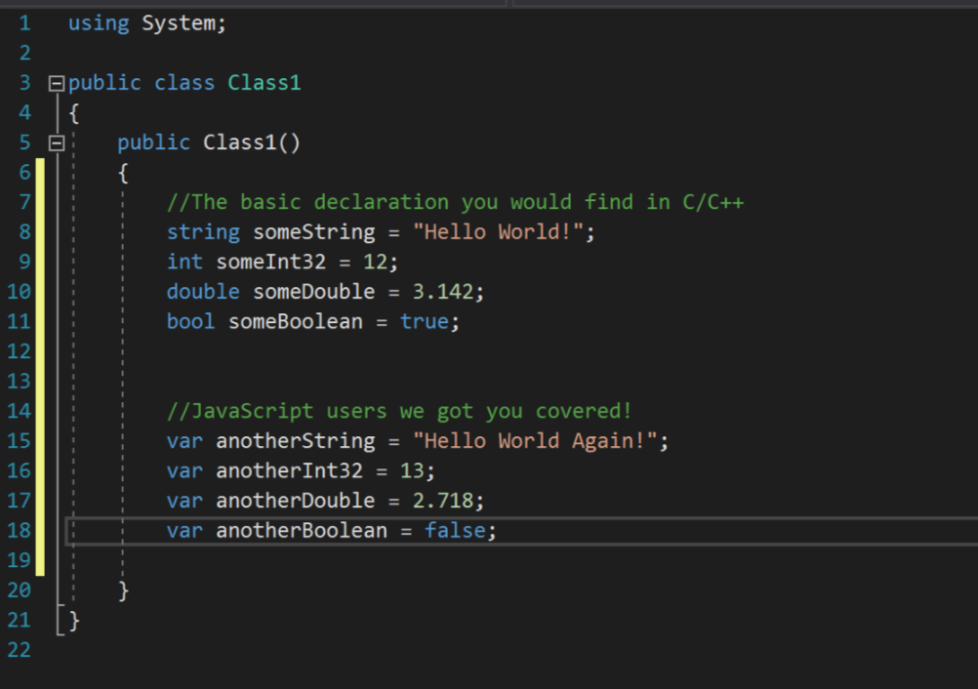
Object Declaration and Initialization

Slide 7
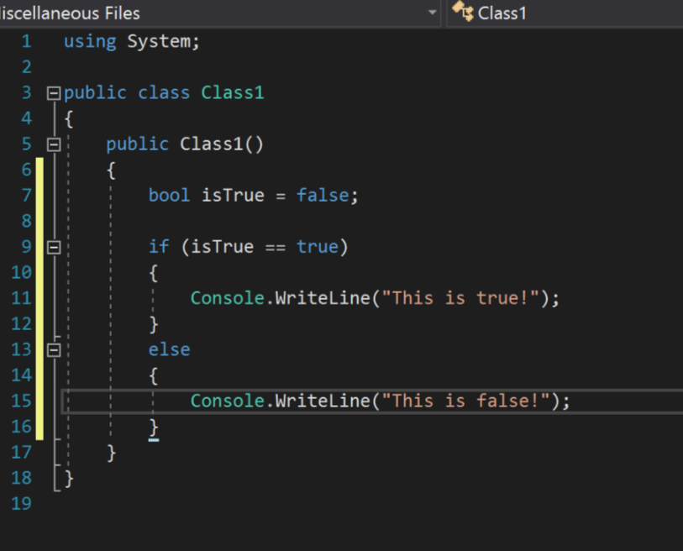
if… else…

Slide 8
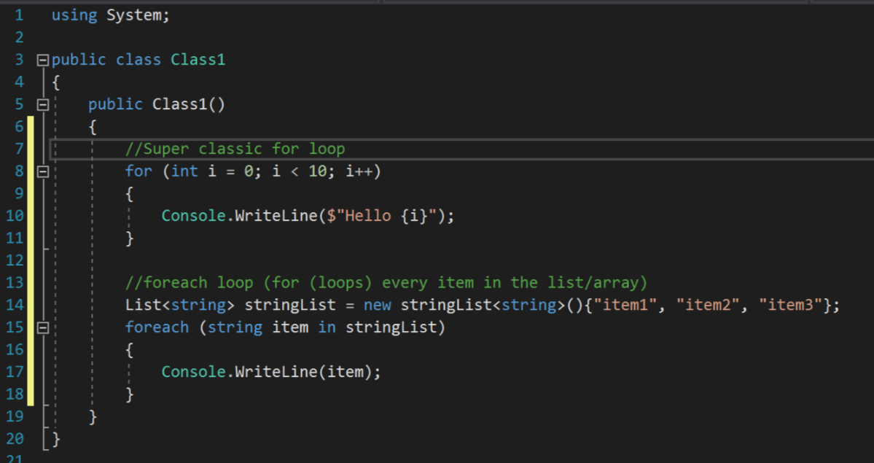
For loops

Slide 9
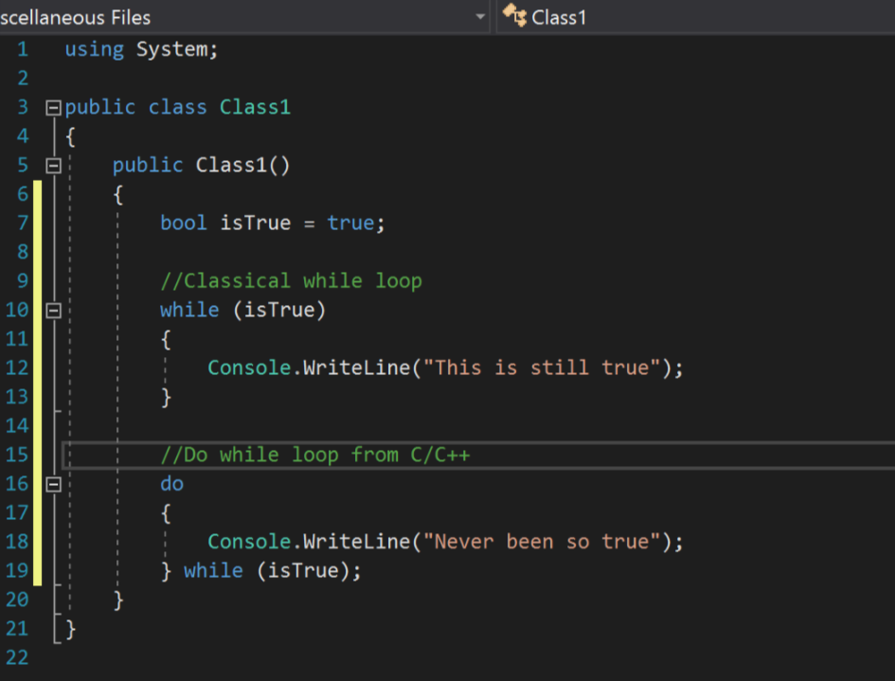
While loops

Slide 10
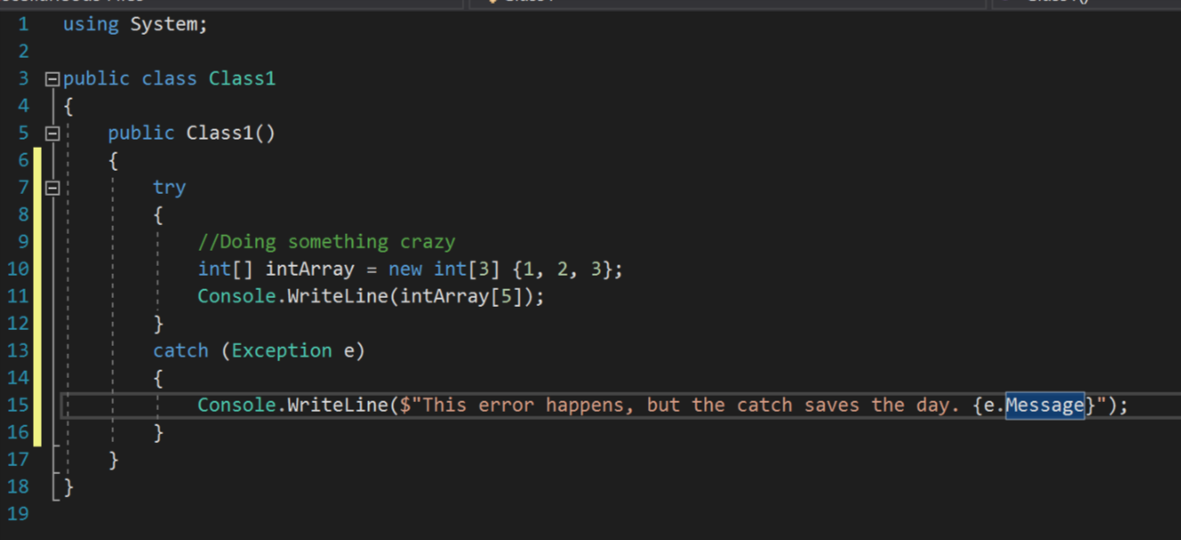
try… catch…

Slide 11
Some other useful things
List
Stores a bunch of object of the same type, something similar to array
Dictionary
Stores a bunch of object of the same type. Each object is assigned and accesed by a key.
Tuple
Stores a bunch of objects of different type
Notes:
Show usage example during this slide

Slide 12
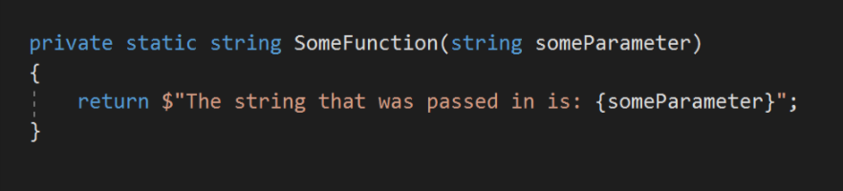













Functions
A function is a way of packaging code that does something and then returns the value.

Slide 13
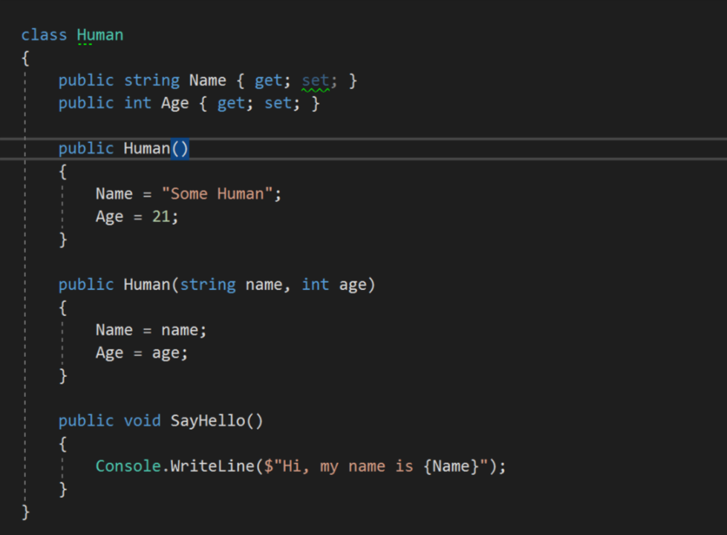



Class
Class can be imagined as an “object”, with properties describing the object, and the object does something (with functions)

Slide 14

Task
Create some classes with relevant properties and functions.
Try to utilize the class you created in the main function!

Slide 15
NEXT WEEK…
How to construct User Interface (UI) using Extensible Application Markup Language (XAML)
Some basic layout types in XAML
Workshop Example Codes available here: https://github.com/NottsCSS/DotNetWorkshop

